Slide 1
Mrs. Jenny Ferguson’s 6th Grade Science Class
6th Grade Science VA SOLs
Scientific Method
Astronomy
Energy

Slide 2
Mrs. Jenny Ferguson’s 6th Grade Science Class
6th Grade Science VA SOLs
Scientific Method
Astronomy
Energy

Slide 3
Mrs. Jenny Ferguson’s 6th Grade Science Class
6th Grade Science VA SOLs
Scientific Method
Astronomy
Energy

Slide 4
Mrs. Jenny Ferguson’s 6th Grade Science Class
6th Grade Science VA SOLs
Scientific Method
Astronomy
Energy

Slide 5


Scientific Method
Scientific Investigation, Reasoning, and Logic

Slide 6
Scientific Method
Scientific Investigation, Reasoning, and Logic
SOL 6.1 The student will plan and conduct investigations in which:
observations are made involving fine discrimination between similar objects and organisms;
a classification system is developed based on multiple attributes;
precise and approximate measurements are recorded;
scale models are used to estimate distance, volume, and quantity;
hypotheses are stated in ways that identify the independent (manipulated) and dependent (responding) variables;
a method is devised to test the validity of predictions and inferences;
one variable is manipulated over time, using many repeated trials;
data are collected, recorded, analyzed, and reported using appropriate metric measurements;
data are organized and communicated through graphical representation (graphs, charts, and diagrams);
models are designed to explain a sequence; and
an understanding of the nature of science is developed and reinforced.

Slide 7

Astronomy

Slide 8
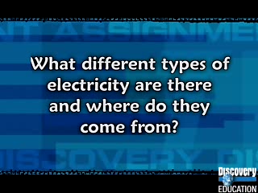
Energy
Force, Motion, and Energy
potential and kinetic energy;
the role of the sun in the formation of most energy sources on Earth;
nonrenewable energy sources (fossil fuels including petroleum, natural gas, and coal);
renewable energy sources (wood, wind, hydro, geothermal, tidal, and solar); and
energy transformations (heat/light to mechanical, chemical, and electrical energy).
SOL 6.3 The student will investigate and understand the role of solar energy in driving most natural processes within the atmosphere, the hydrosphere, and on the Earth’s surface. Key concepts include:
the Earth’s energy budget;
the role of radiation and convection in the distribution of energy;
the motion of the atmosphere and the oceans;
cloud formation; and
the role of heat energy in weather-related phenomena including thunderstorms and hurricanes.
SOL 6.2 The student will investigate and understand basic sources of energy, their origins, transformations, and uses. Key concepts include:

